Slide 1
Poor Richard's Memory Manager
Tongxin Bai, Jonathan Bard, Stephen Kane, Elizabeth Keudel, Matthew Hertz, & Chen Ding Canisius College
Notes:
Say who is talking

Slide 2


GC Performance
Good news: GC performance is competitive
Matches average performance of good allocator
Ran some benchmarks up to 10% faster
Bad news: GC is serious memory hog
Footprint 5x larger for quickest runs
All runs had at least double the footprint
GC’s paging performance is bad
Notes:
Lots of system use GC because of the system engineering benefits it provides
GC performance is competitive with explicit memory manager

Slide 3
GC Performance
Good news: GC performance is competitive
Matches average performance of good allocator
Ran some benchmarks up to 10% faster
Bad news: GC is serious memory hog
Footprint 5x larger for quickest runs
All runs had at least double the footprint
GC’s paging performance is bad horrible

Slide 4
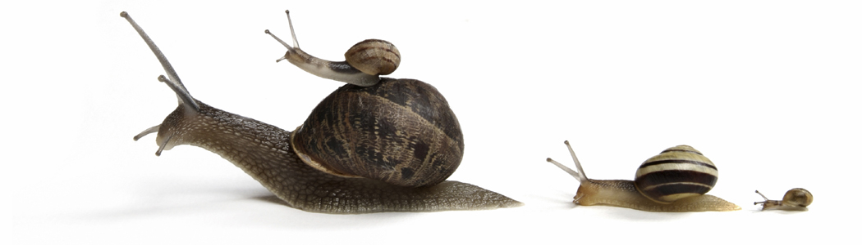
GC Performance
Good news: GC performance is competitive
Matches average performance of good allocator
Ran some benchmarks up to 10% faster
Bad news: GC is serious memory hog
Footprint 5x larger for quickest runs
All runs had at least double the footprint
GC’s paging performance is bad horrible
Notes:
Slower than a snail's pace

Slide 5
Ways To Make A Computer Cry
Notes:
Shows time executing pseudoJBB – JavaBeans enterprise server-like app
Y-axis shows time to execute application
X-axis shows available memory in the system
2 different collectors; performance plummets as soon as paging starts

Slide 6
What Can We Do?
Select a good heap size to "solve" problem
Large enough to use all available memory…
…but not trigger paging by being too large
May be able to find on dedicated machine
If stuck working in 1999, this is excellent news
What about multiprocessor, multicore machines?
Available memory fluctuates with each application
Notes:
2 small leads to 2 many GCs; 2 large leads to 2 many page faults;
Need medium size
When I was 11 possible, but with multicore, multiprocessor running many applications this is not.

Slide 7

What Can We Do?

Slide 8

What Can We Do?
or
Notes:
Ben Franklin's advice

Slide 9
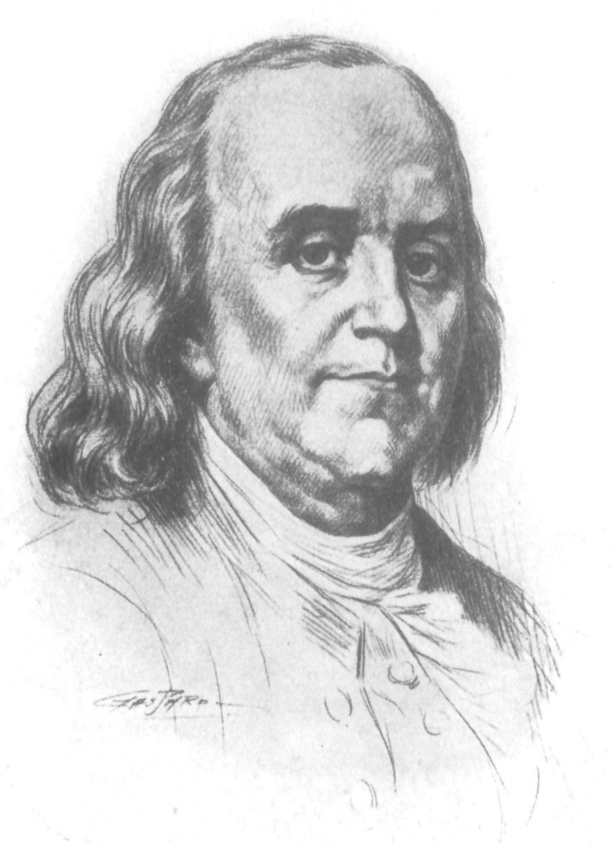
Our First Inspiration
Little strokes fell great oaks

Slide 10

Our Idea
Maintain performance of existing collectors
Assume that paging is not common case
Keep changes small & outside of current systems
Focus on the correct problem: page faults
No serious slowdown from small number of faults
Instead need to prevent faults from snowballing
Notes:
Small number of faults could be coincidence or accident
Heap too large must shrink heap size

Slide 11
Our Approach
Process will check fault count periodically
Tolerate a few new faults at each check, but…
…must act when faults are too high
Prevent slowdown caused by many faults
Force garbage collection once enough faults seen
GC reduces pages needed & keeps them in RAM
Pressure now dealt with; so heap can regrow

Slide 12
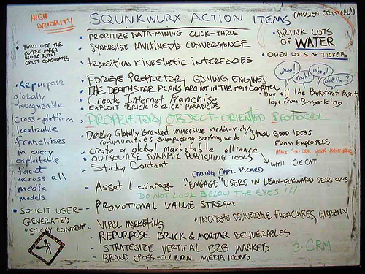
Memory is System-Wide
Share information using whiteboard

Slide 13
Memory is System-Wide
Share information using whiteboard
Alert all processes when increased faults detected
Check for alert during periodic fault count check
Even if no fault locally, collect heap when alerted
Whiteboard prevents run on memory, also
Collection temporarily increases memory needs
Paging is worsened by all processes GC at once
Processes use whiteboard to serialize collections

Slide 14
Experimental Methodology
Java platform:
MMTk/Jikes RVM 3.0.1 (revision 15128)
PseudoAdaptive compiler & GenMS collector
Hardware:
Dual 2.8 GHz Xeon w/ hyperthreading turned on
Booted with option "mem=256M" limiting memory
Operating System:
Ubuntu 9.04 (Linux kernel 2.6.28-13)
Notes:
Compilation costs
Cannot start from clean system

Slide 15
Experimental Methodology
Benchmarks used:
pseudoJBB – fixed workload variant of SPECjbb
bloat, fop, pmd, xalan – from DaCapo suite
DaCapo benchmarks looped multiple times
Initial (compilation) run included in results
When not paging, runs total about 1:17
Ran 2 benchmarks simultaneously
Record time until both processes completed

Slide 16
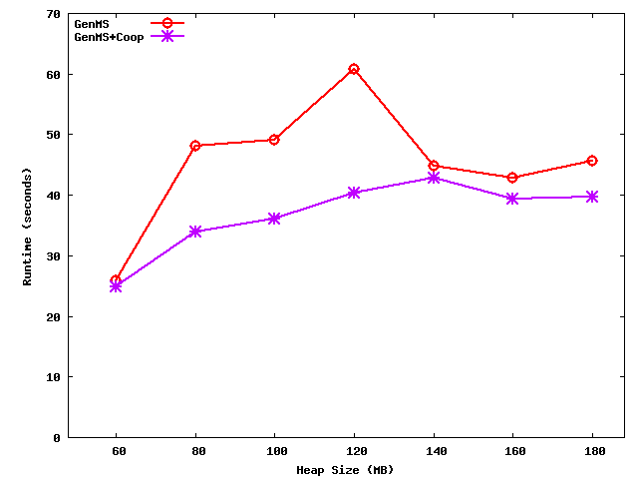
Little Strokes Fell Great Oaks
Time Needed to Complete pseudoJBB Runs
Notes:
Y – runtime
X- heap size

Slide 17
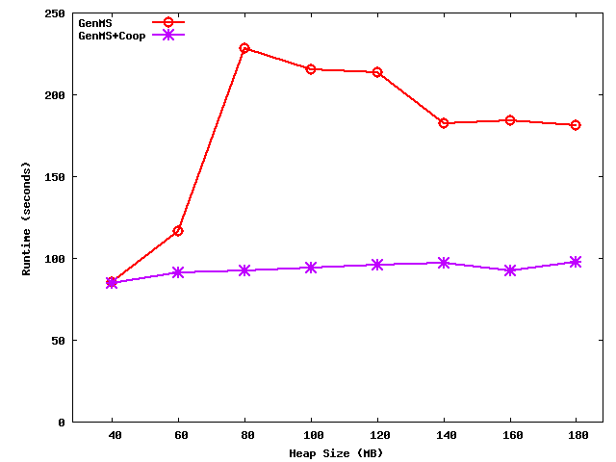
Little Strokes Fell Great Oaks
Time Needed to Complete Bloat-Fop Runs
Notes:
Cooperative line is flat; paging was nearly non-existent

Slide 18
Our Second Inspiration
Early bird catches the worm

Slide 19
Problem With Faults
Page faults help keep heap in available RAM
Faults detectable only after heap grew too big
Usually good enough to avoid major slowdowns
And may cause problems if evicted pages unused
Better knowing before pages faulted back in
Could shrink heap earlier and avoid page faults
Changes to OS, JVM, GC to send & receive alerts
Ideally would have a more lightweight solution

Slide 20
RSS Is Not Just For Blogs
Resident set size available with fault count
Records number of pages currently in memory
RSS goes up when pages touched or faulted in
If pages unmapped or evicted, RSS goes down
RSS provides early warning in steady state
Will eventually see pages faults after RSS drops
Assumes pages not released as app executes
(Safe assumption that holds in most systems)
Notes:
When RSS shrinks, page faults will be occurring. It provides an early warning

Slide 21
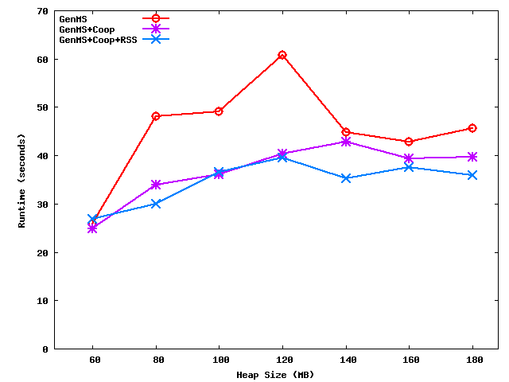
Early Bird Catches The Worm
Time Needed to Complete pseudoJBB Runs
Notes:
Y = runtime
X = Heap
RSS line is nearly flat; correct heap size no matter what the user typed

Slide 22
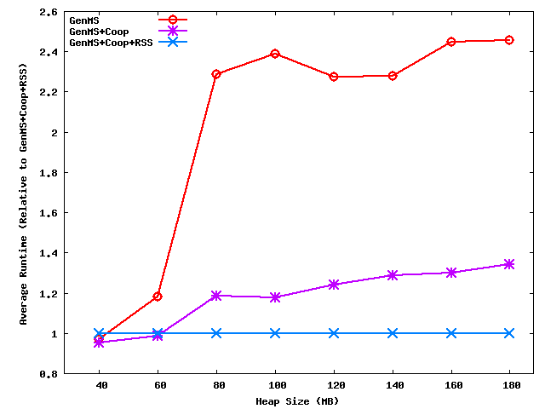
Early Bird Catches The Worm
Average Result Across All Our Experiments
Notes:
Y = Geometric mean relative to Cooperative + RSS
By definition our Coop + RSS is at 1.0 – slower runs are at higher numbers; faster runs are at lower numbers
X = heap

Slide 23
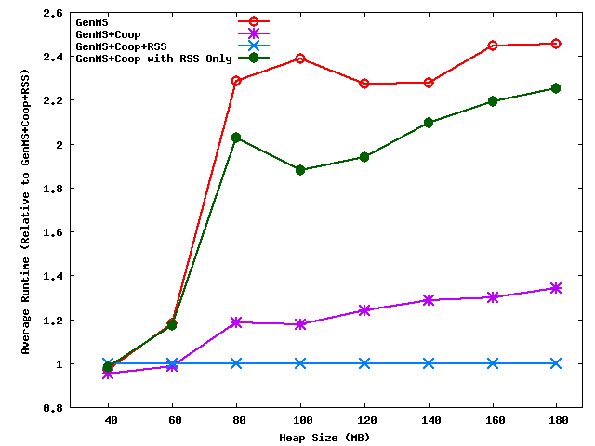
RSS Is Not A Panacea
Average Result Across All Our Experiments
Notes:
Added a run that only uses RSS (no page fault trigger) to previous graph
RSS only performs worse than page fault count only, but better than default system

Slide 24
Our Third Inspiration
The Lord helps those who help themselves

Slide 25
"Greed Is Good"
Previously results showed cooperative work
Individually track page faults & RSS for alerts
Changes share and reacted to on collective basis
System-wide resource so this would make sense
But there are some costs to cooperation
Mutexes used to protect critical sections
Sharing enabled by allocating more memory
Extra collections triggered & may not be needed
Notes:
we saw
overhead , locks, whiteboard, gcs

Slide 26
Process Help Thyself
Selfish approach similar to previous system
Continues to periodically check page faults & RSS
Trigger collection on too many faults or RSS drop
Other applications will not be sent update
Simultaneous collections will not be prevented
Initially rejected as appears this is a bad idea
But done well by Ben Franklin so far…
Notes:
think before talk
we thought
no inter communications between processesthat are selfish

Slide 27
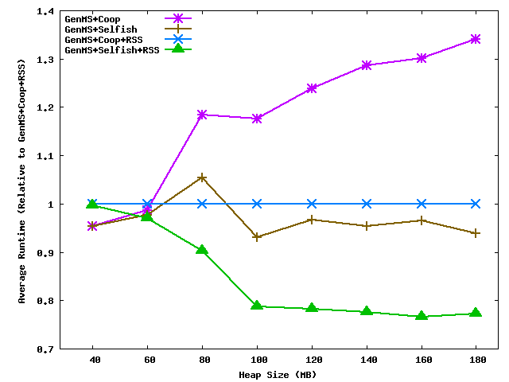
Those Who Help Themselves
Average Result Across All Our Experiments
Notes:
geometric mean
as memory pressure increases selfish runs grow better

Slide 28
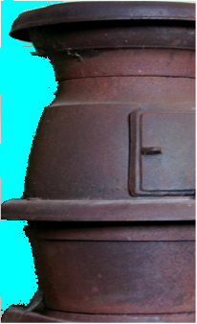
Our Last Inspiration
Only 2 certainties in life,
death & taxes

Slide 29
Our Last Inspiration (Almost)
Only 2 certainties in life,
death & taxes
3
& Poor Richard
Notes:
memory manager

Slide 30
Advice Good In Many Situations
Inspiration very general & so was code
Approach was independent of GC algorithm
Few changes needed to Jikes RVM (< 30 LOC)
Majority of code written in standalone file
Could other collectors benefit from this?
Others tend to be less resilient to paging
Uses more pages with quicker growth to RSS
(At least in Jikes, usually perform much worse)
Notes:
other collectors grow faster and use more pages

Slide 31
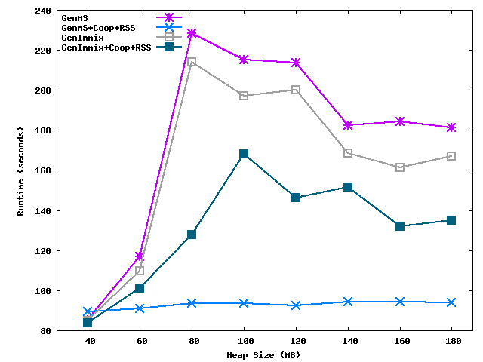
Let's Hear It For Poor Richard!
Time Needed to Complete Bloat-Fop Runs
Notes:
made improvements in all collections

Slide 32
Does This Really Hold?
Also tested in Mono Virtual Machine
Open-source system for running .Net programs
BDW collector for whole-heap, non-moving GC
Written for C, BDW cannot shrink heap
Fewer than 10 LOC modified during port
Bulk of PRMM code copied without modification
Notes:
and copy a file over

Slide 33
Let's Hear It For Poor Richard!
Notes:
PRMM relative performance improves (from 1.5x faster to 1.69x faster) as the ratio of short-lived objects increases (naturally)
changed where our triggers are inserted,
improved upon these results even further

Slide 34
Conclusion
Poor Richard's advice continues to hold
PRMM solves GC's paging problem
Few changes needed to add to existing systems
When not paging, good performance is maintained
Averages 2x speedup for best collector
Improves nearly every algorithm and system
Notes:
twice as fast

Slide 35
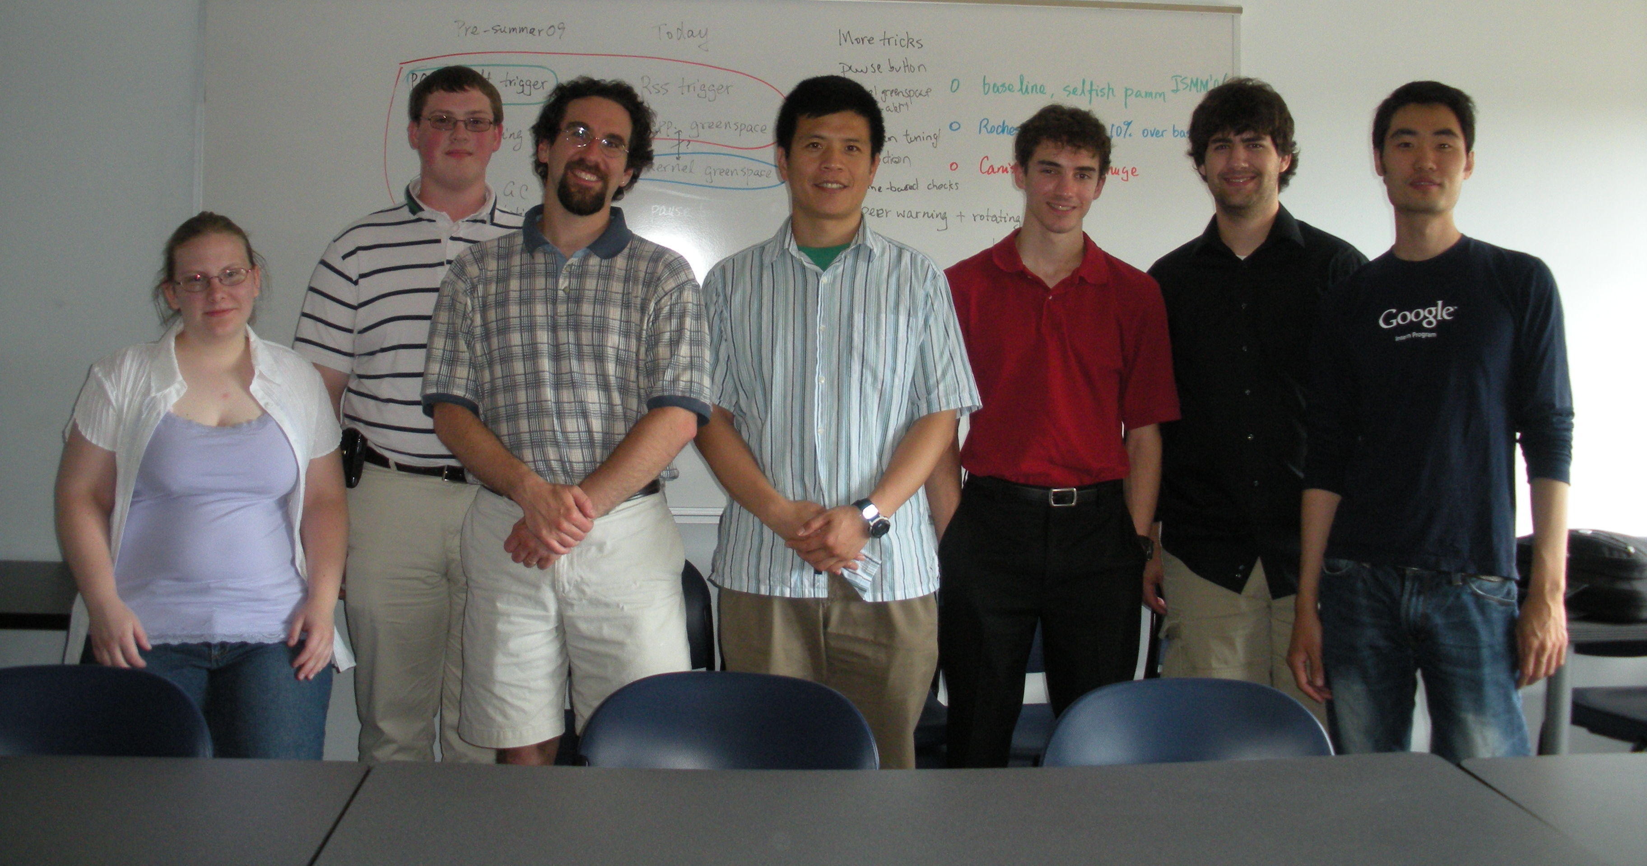
The Team
Notes:
Thank you

